Slide 1
Artificial Intelligence DR.Abeer Amer

Slide 2
Uniform-Cost Strategy
Each step has some cost ≥ ε > 0.
The cost of the path to each fringe node N is
g(N) = Σ costs of all steps.
The goal is to generate a solution path of minimal cost.
The queue FRINGE is sorted in increasing cost.
A
S
1
10
0
S
5
B
5
G
A
B
C
1
5
15
5
15
C
G
G
Nodes List = (S0)
Nodes List = (A1, B5, C15) Nodes List = (B5, G11, C15) Nodes List = (G10, G11, C15)
11
10

Slide 3
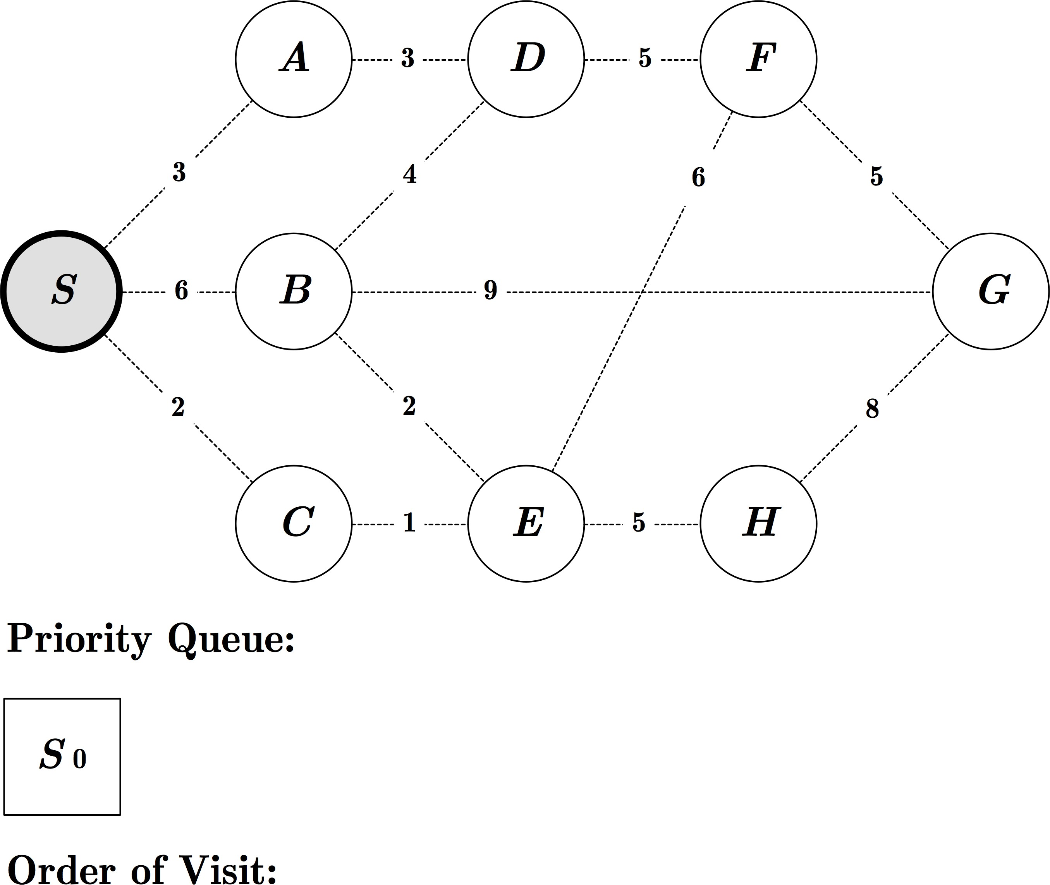
Exercise: UCS

Slide 4
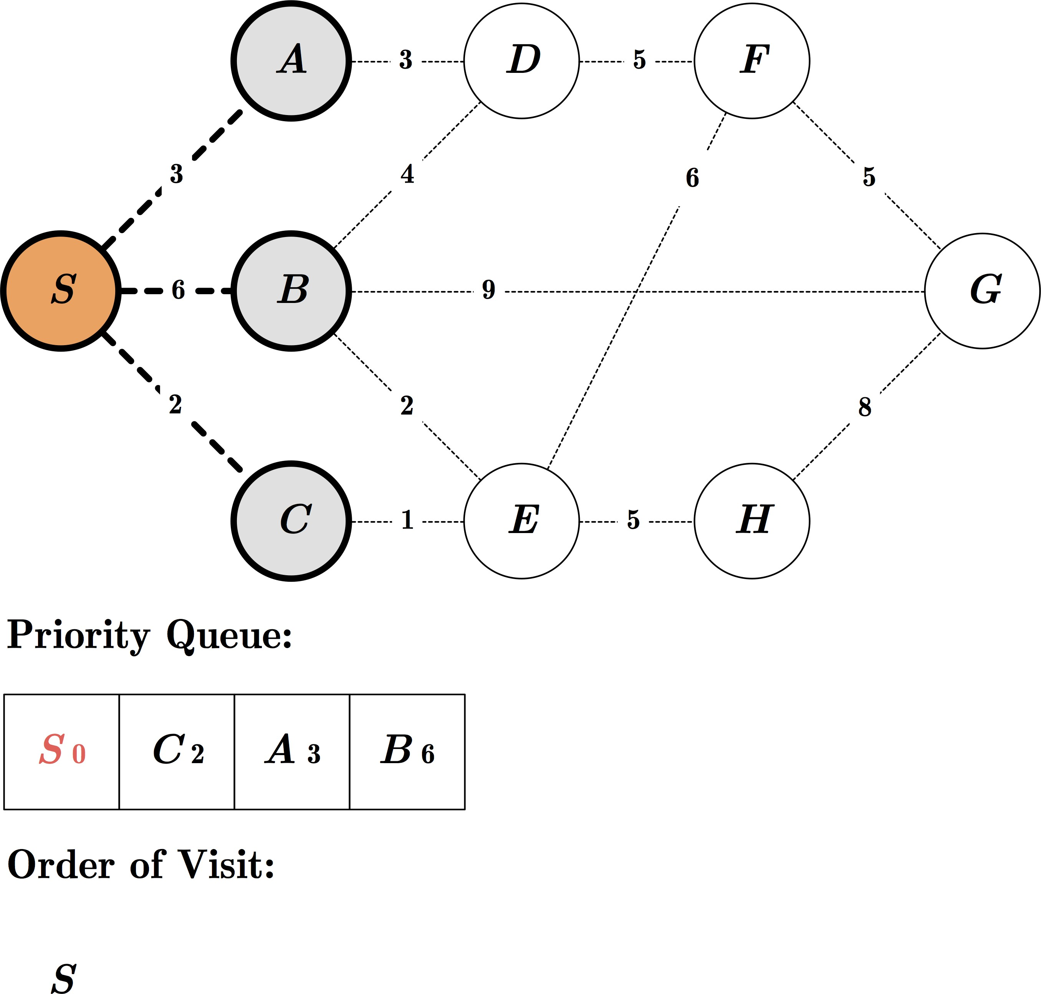
Exercise: UCS

Slide 5
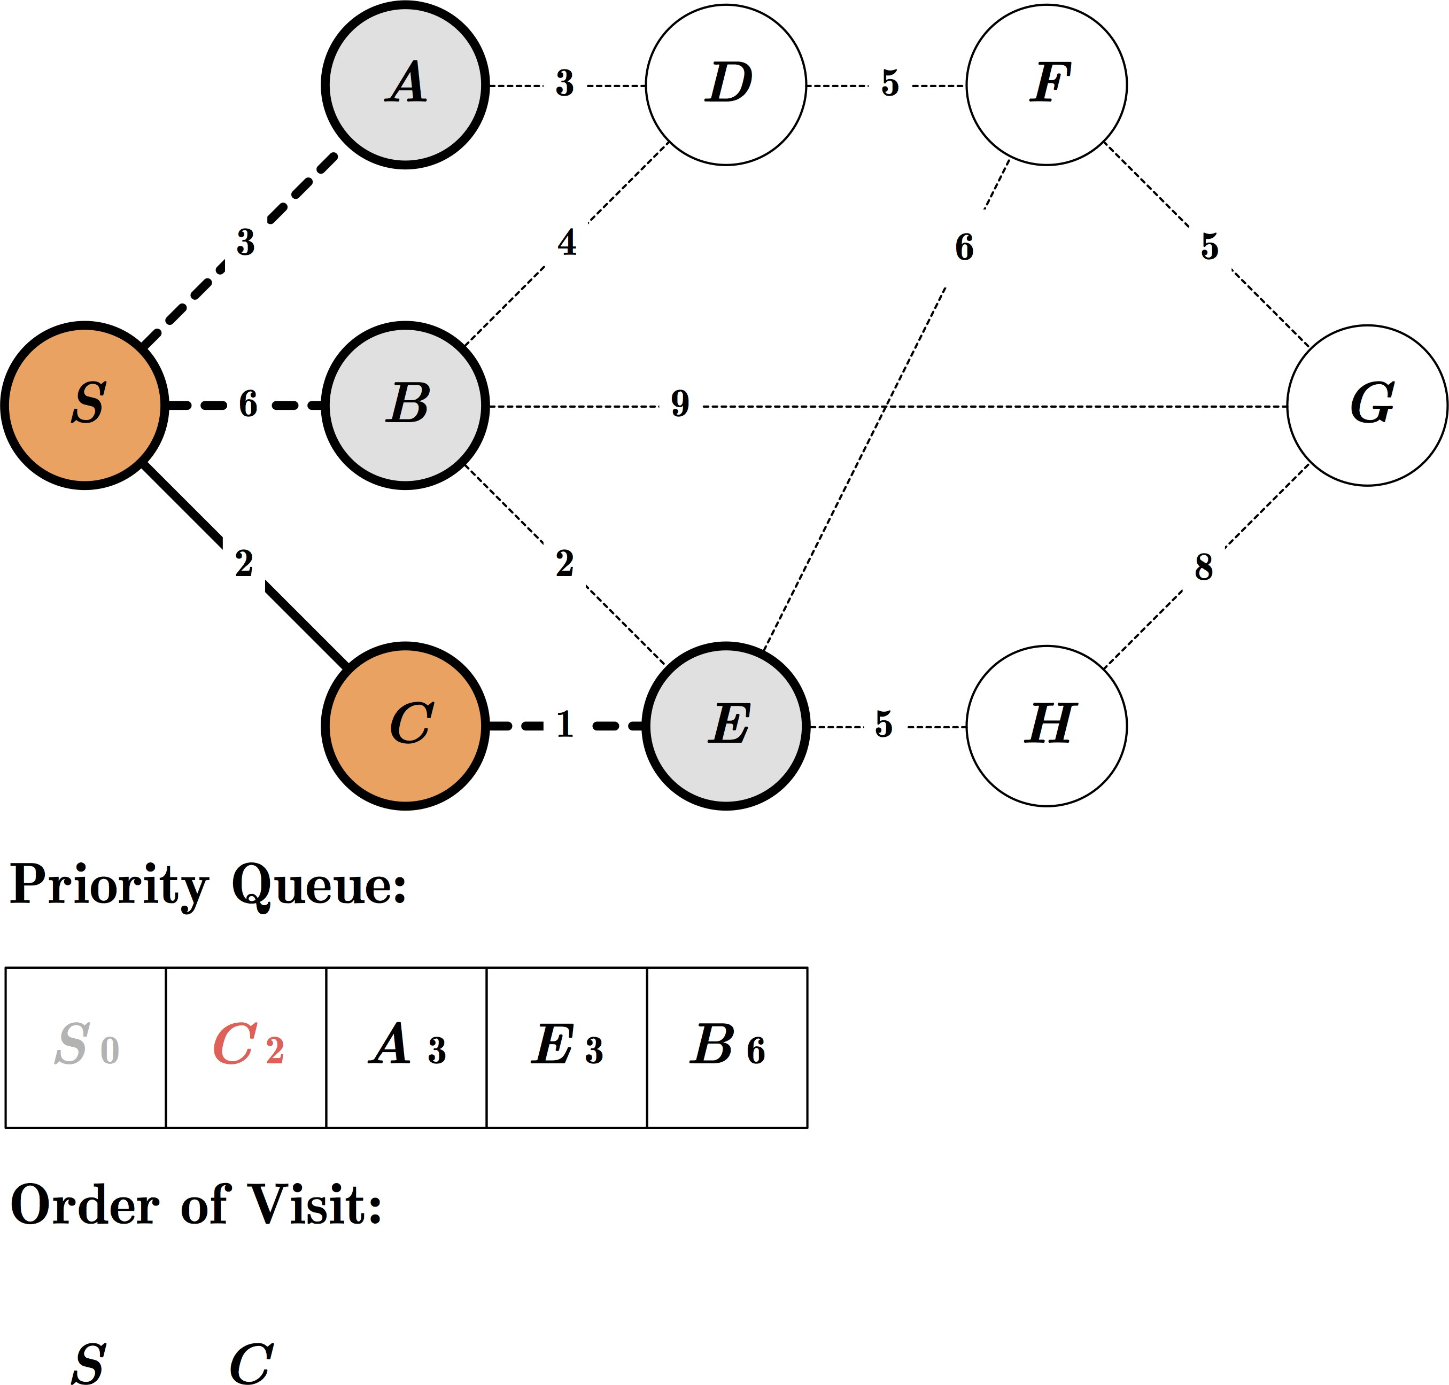
Exercise: UCS

Slide 6
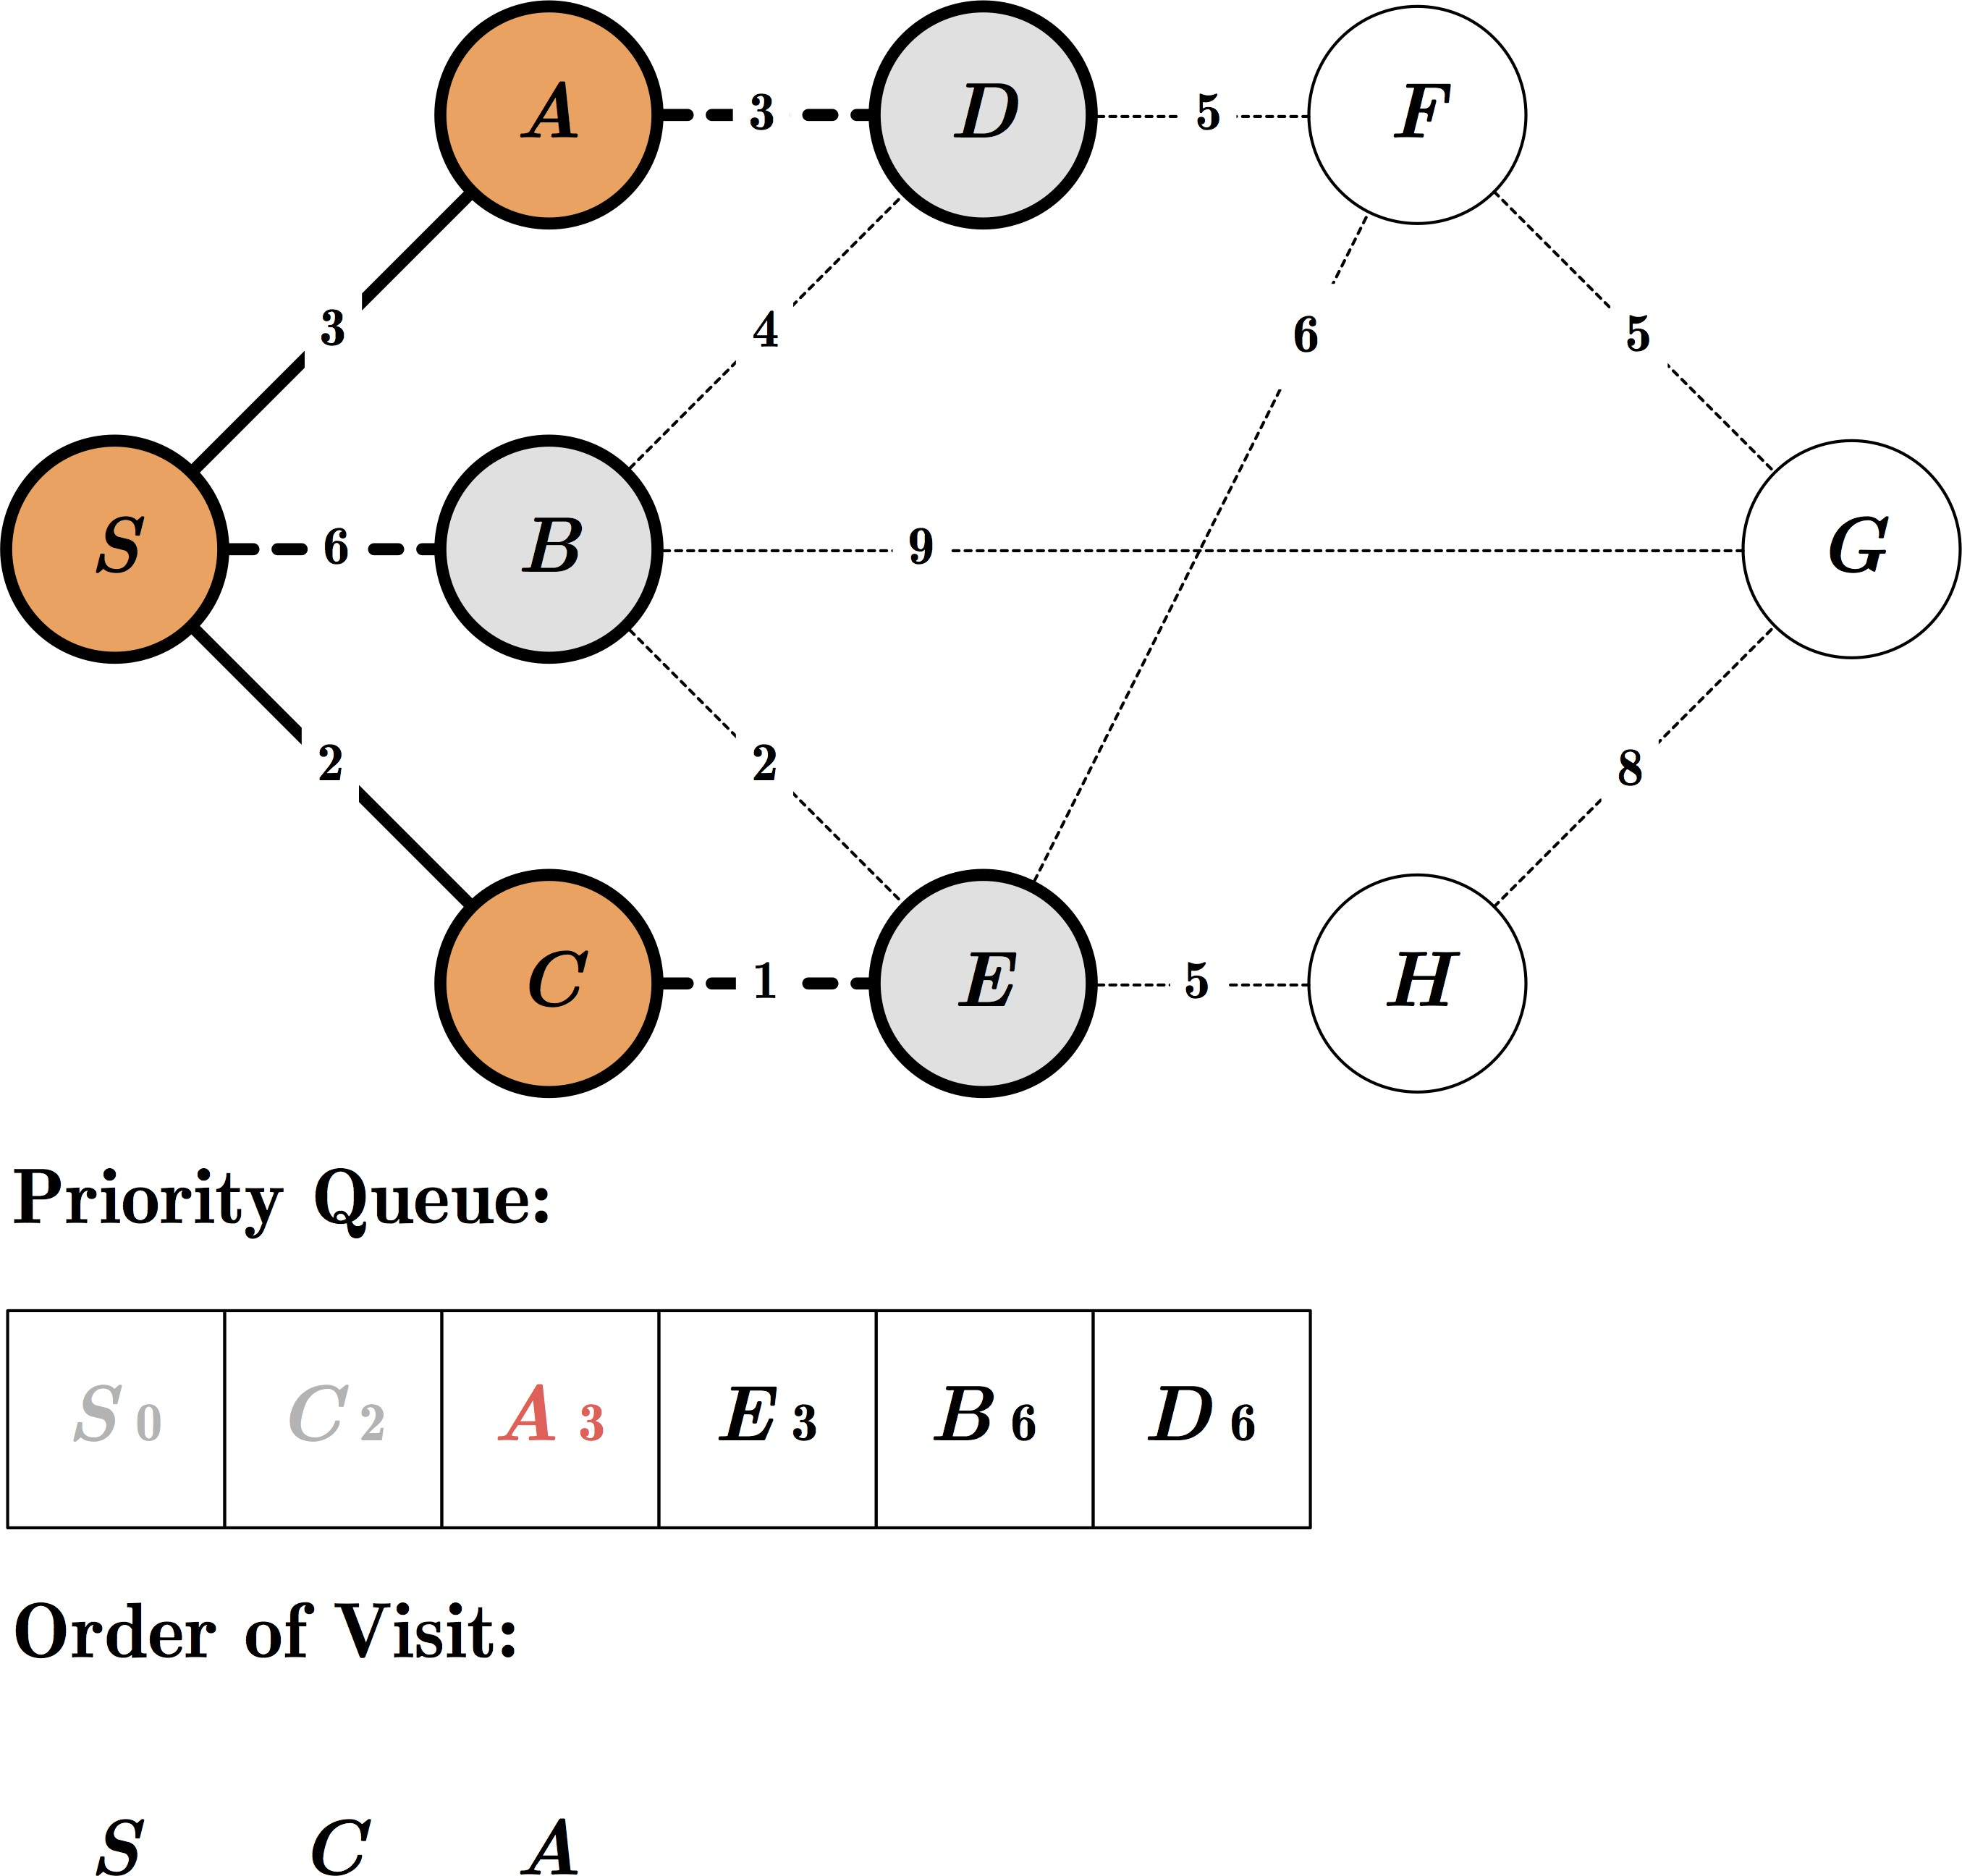
Exercise: UCS

Slide 7
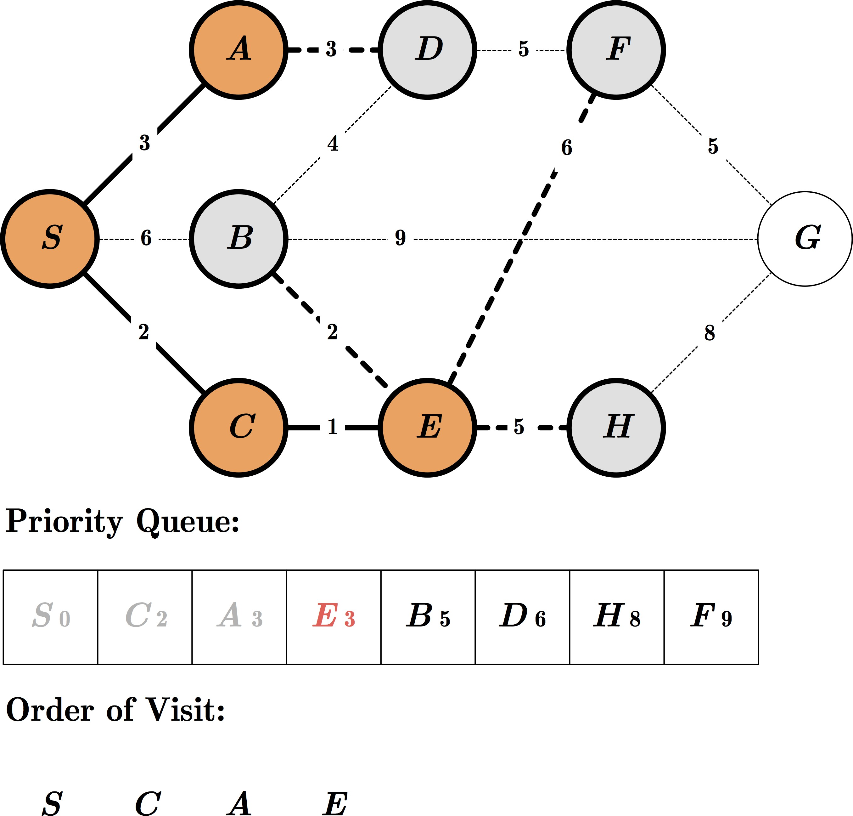
Exercise: UCS

Slide 8
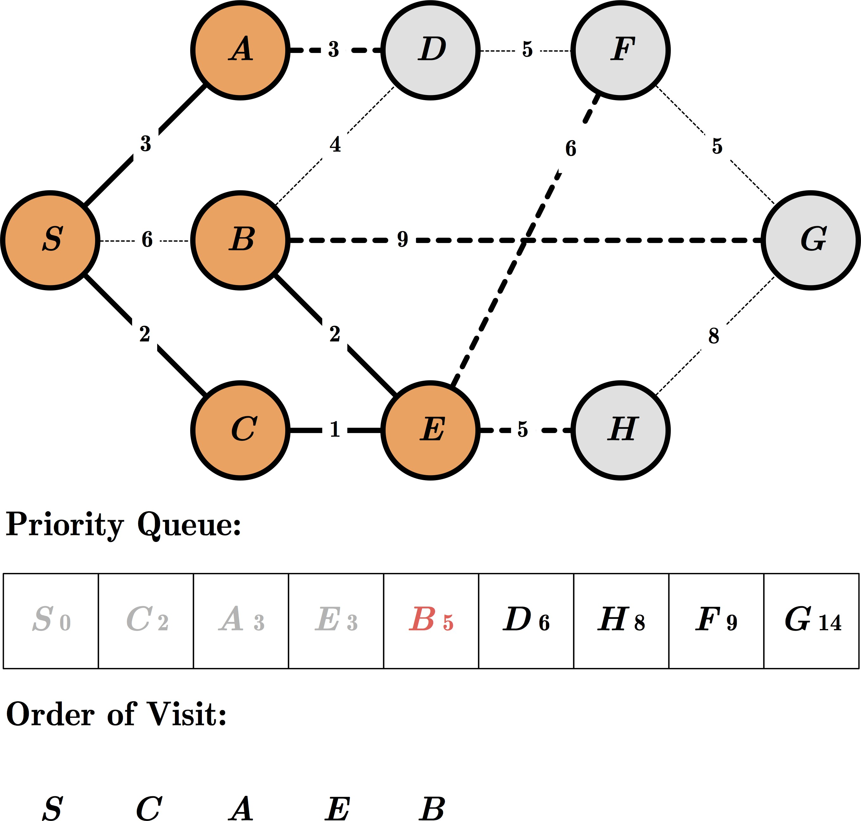
Exercise: UCS

Slide 9
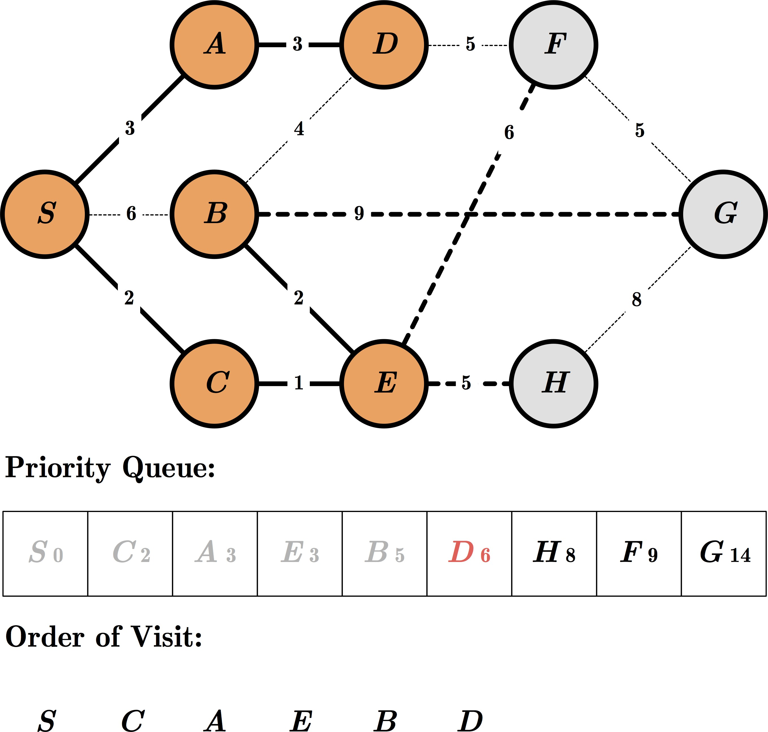
Exercise: UCS

Slide 10
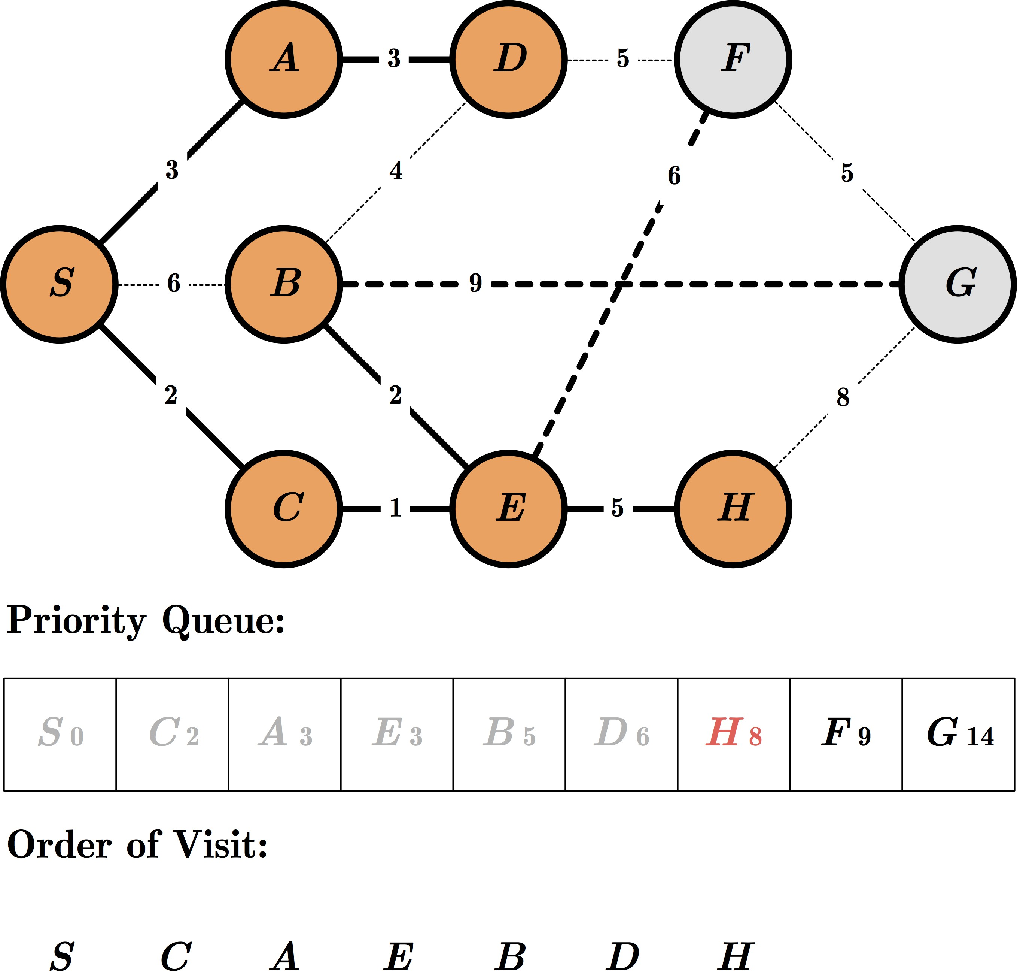
Exercise: UCS

Slide 11
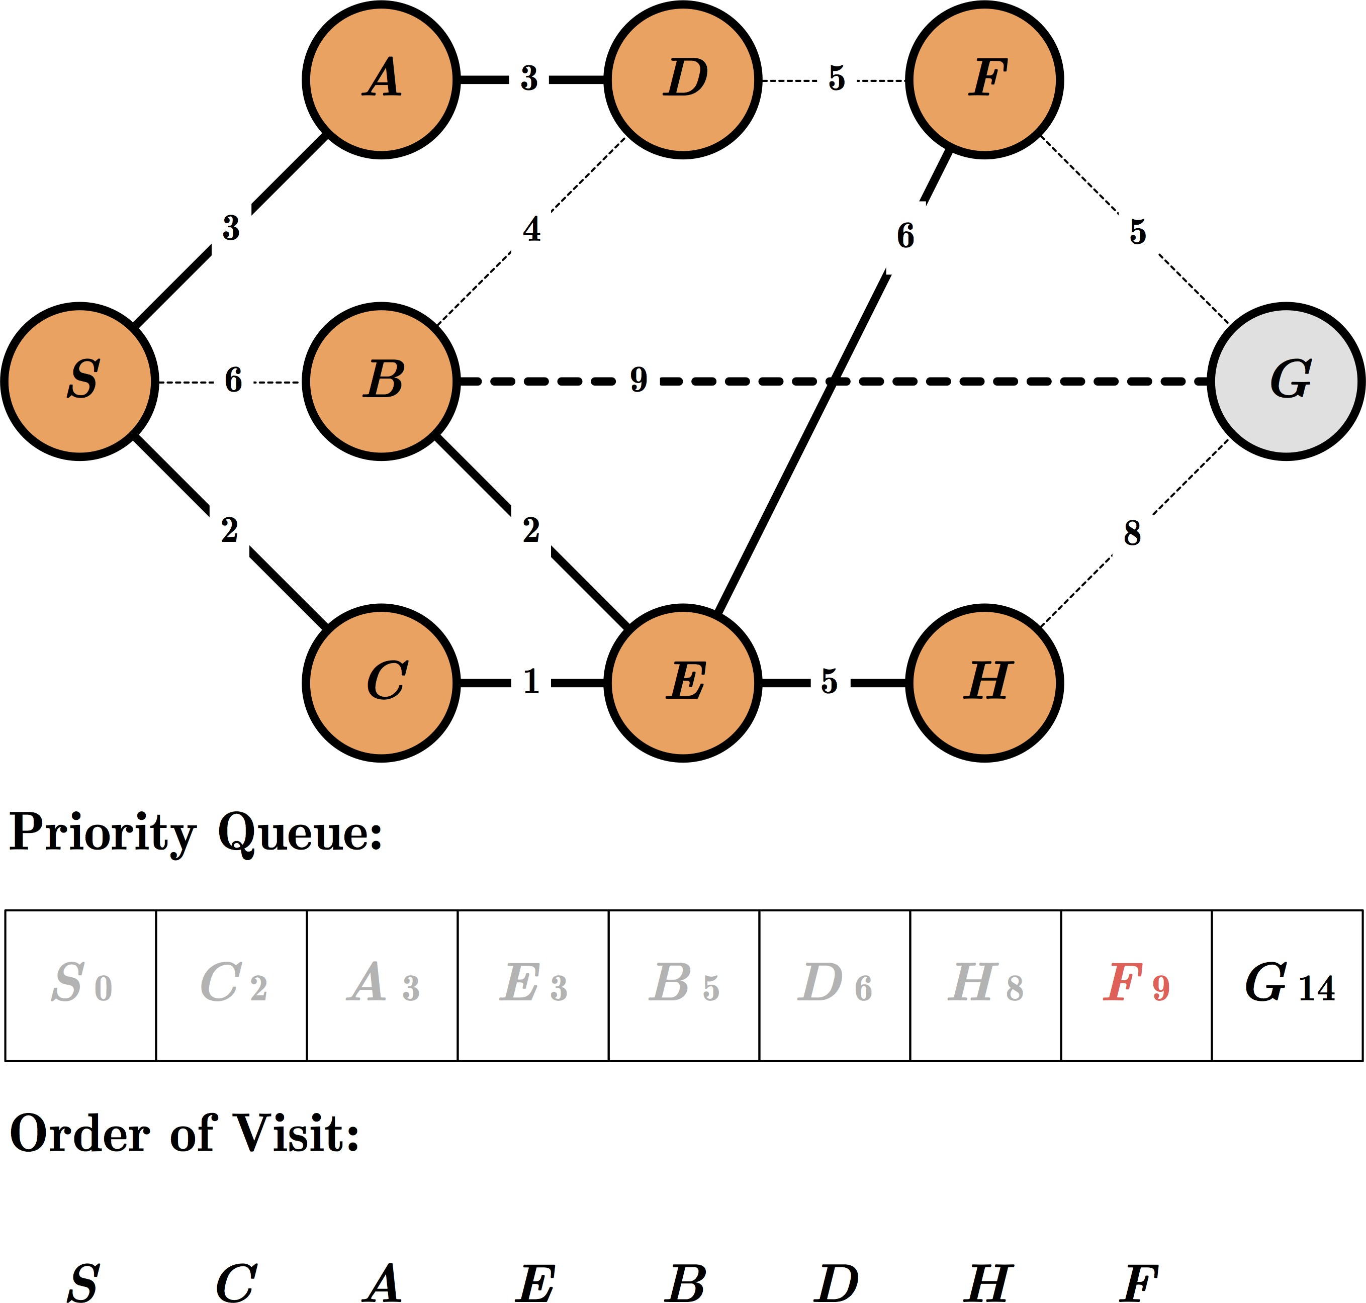
Exercise: UCS

Slide 12
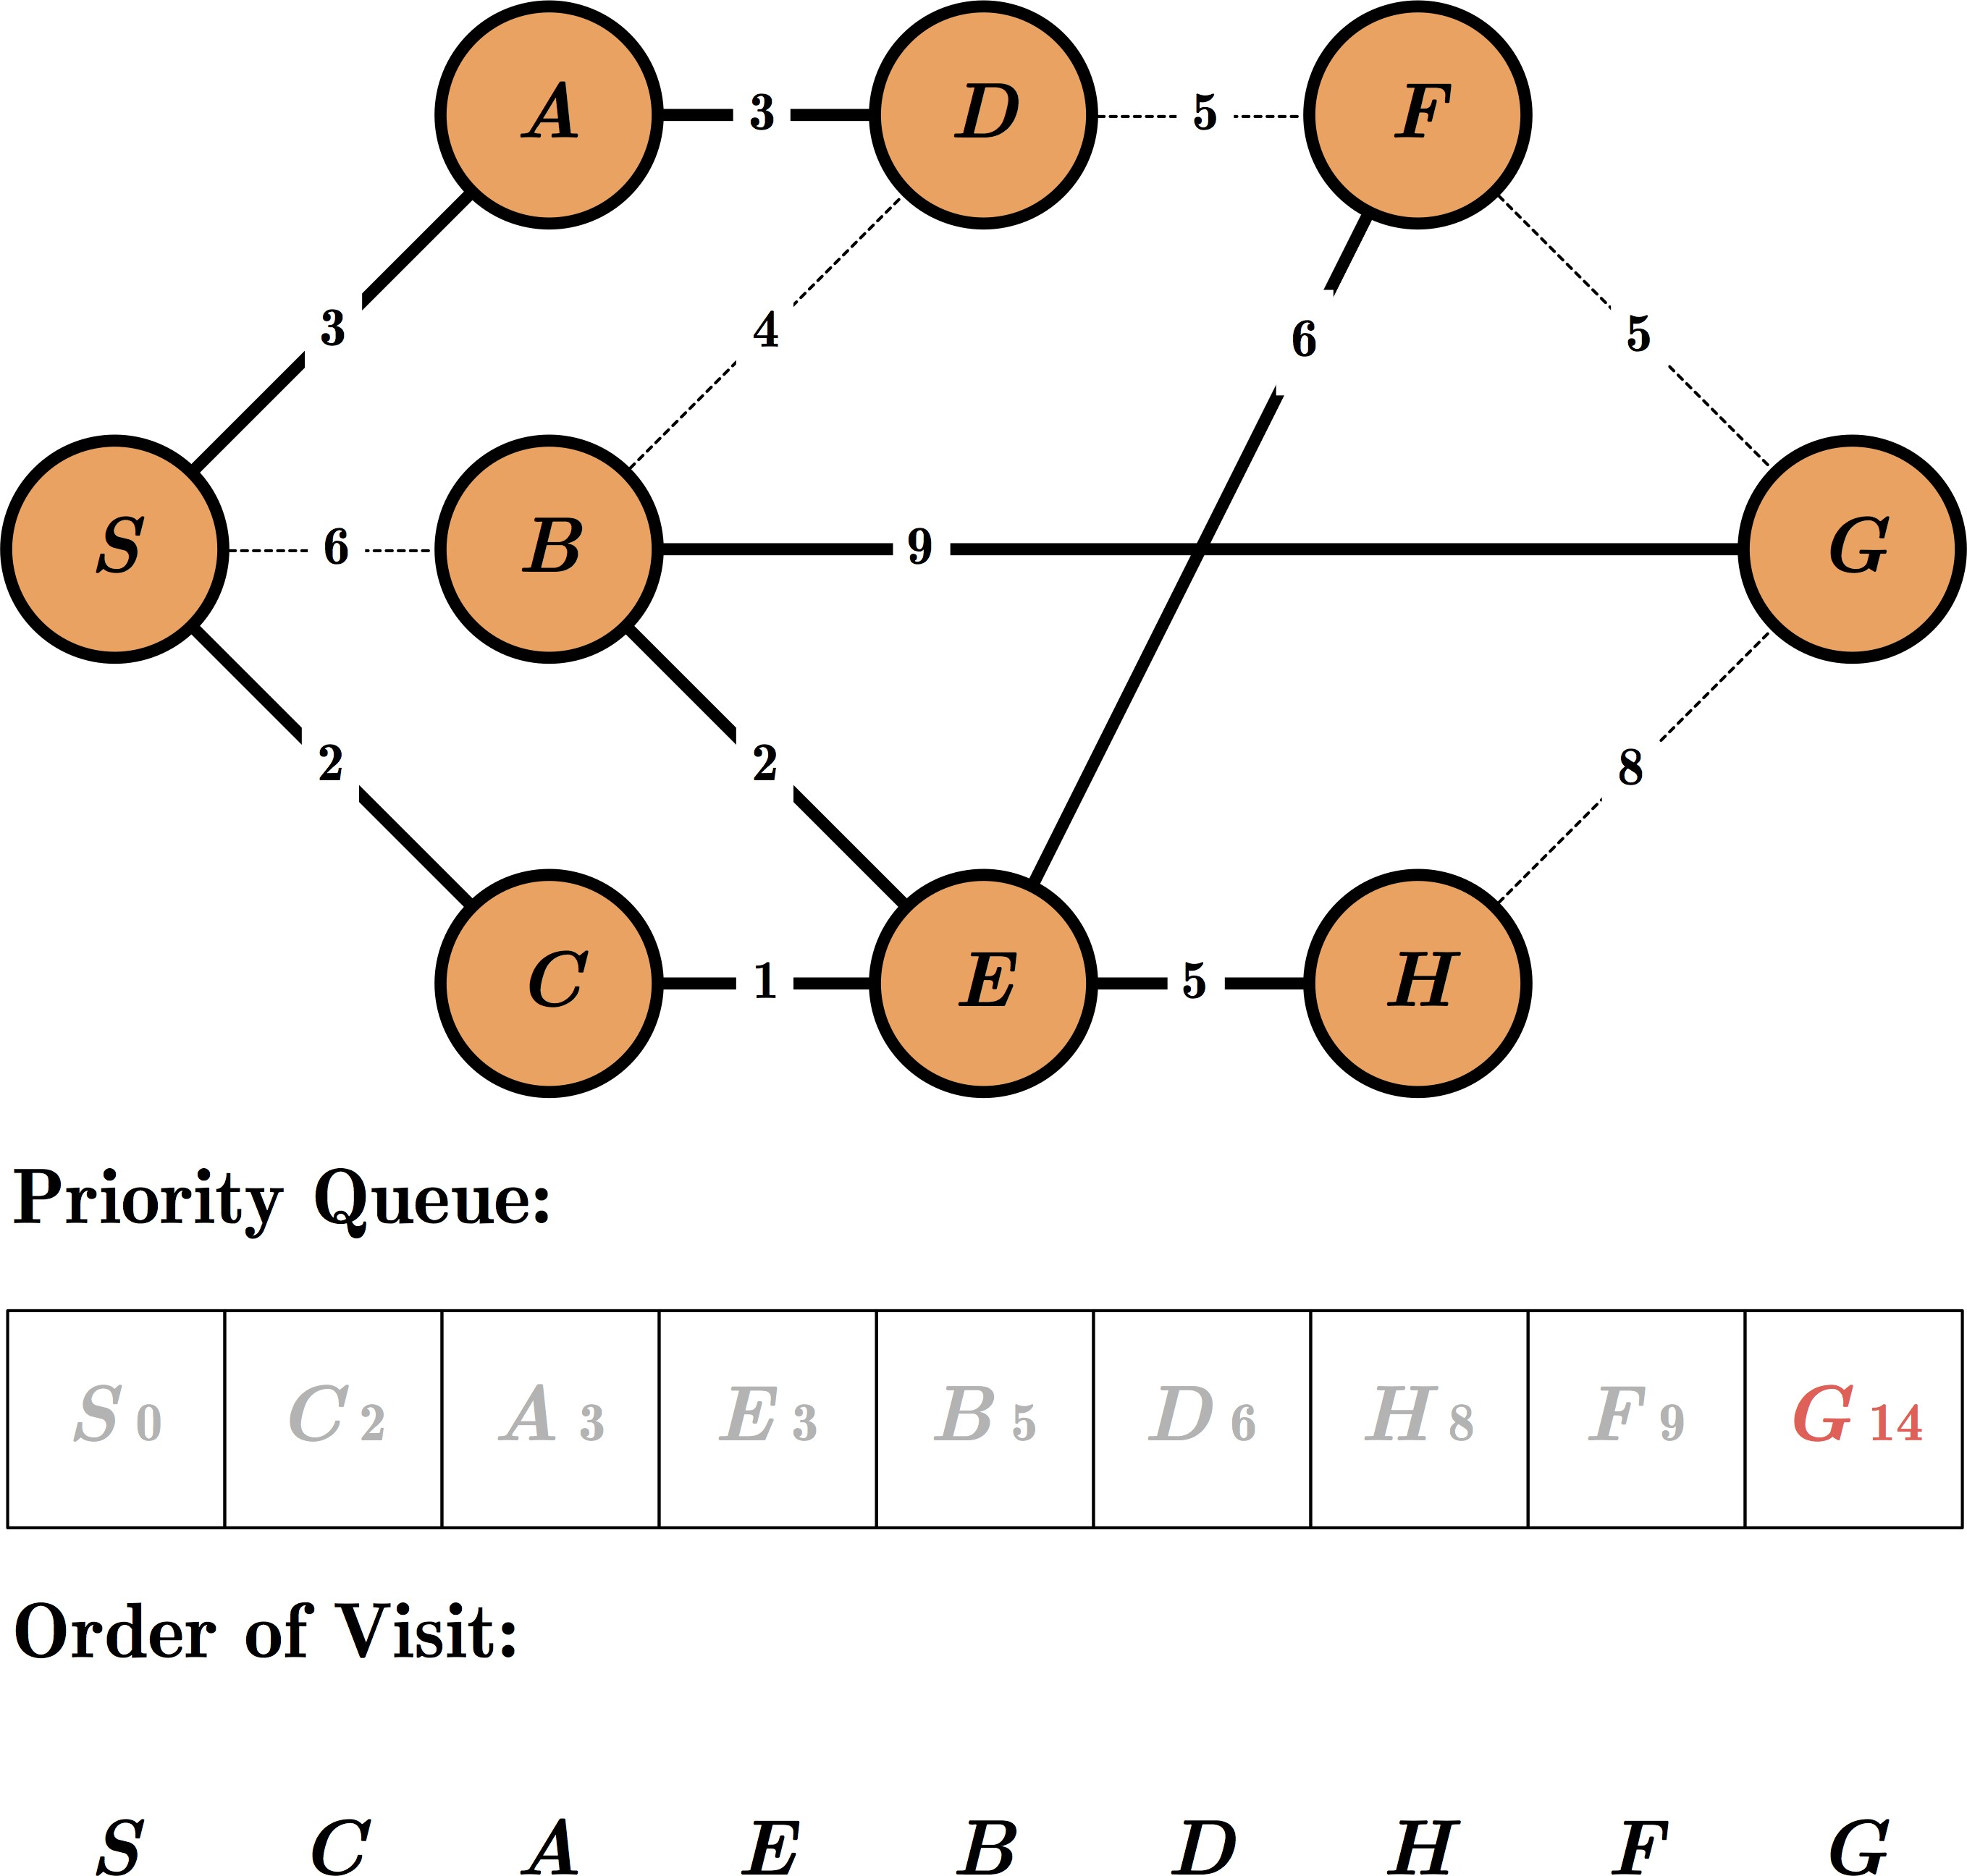
Exercise: UCS

Slide 13
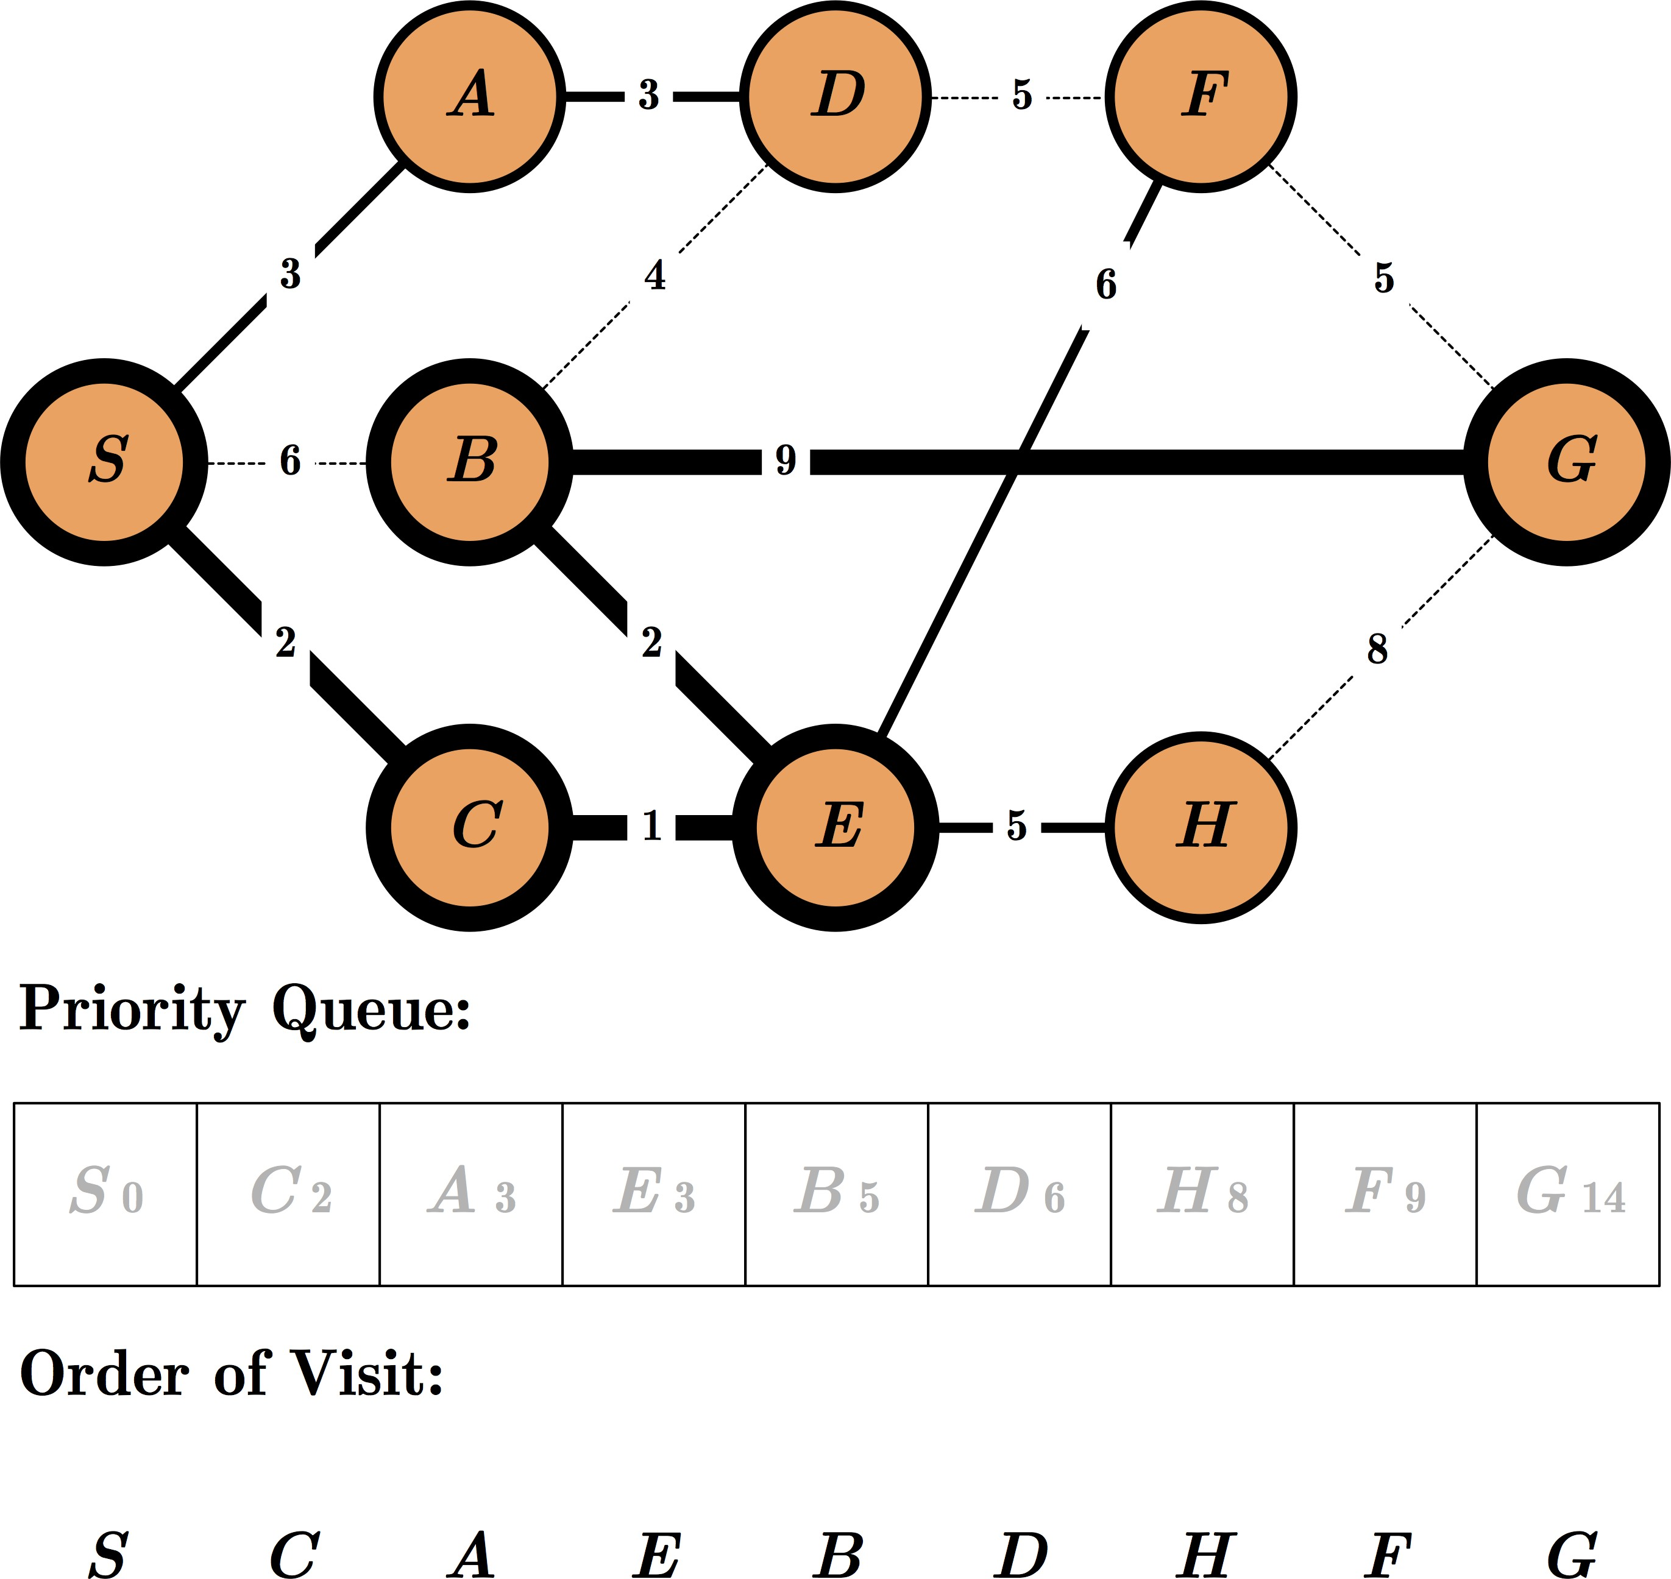
Exercise: UCS

Slide 14

Informed Search
[ Heuristic Search ]

Slide 15
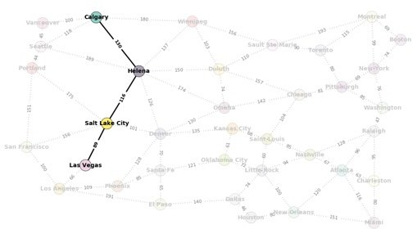
Artificial Intelligence
Search Agents Informed search

Slide 16
Informed search
Use domain knowledge!
Are we getting close to the goal?
Use a heuristic function that estimates how close a state is to the goal
A heuristic does NOT have to be perfect!

Slide 17
Informed search
Use domain knowledge!
Are we getting close to the goal?
Use a heuristic function that estimates how close a state is to the goal
A heuristic does NOT have to be perfect!
Example of strategies:
Greedy best-first search
A* search
IDA*

Slide 18
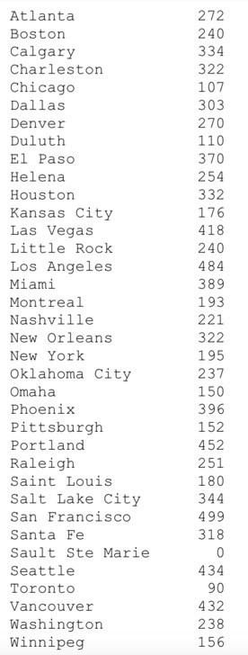
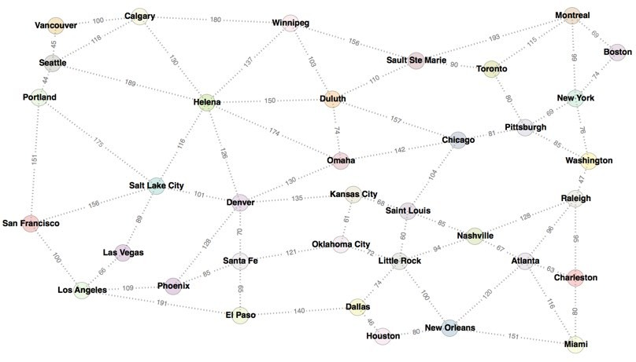
Informed search
Heuristic!
The distance is the straight line distance. The goal is to get to Sault Ste Marie, so all the distances are from each city to Sault Ste Marie.

Slide 19
Greedy search
Evaluation function h(n) (heuristic)
h(n) estimates the cost from n to the closest goal
Example: h_{SLD}(n) = straight-line distance from n to Sault Ste Marie
Greedy search expands the node that appears to be closest to goal

Slide 20

Greedy search example
The initial state:

Slide 21
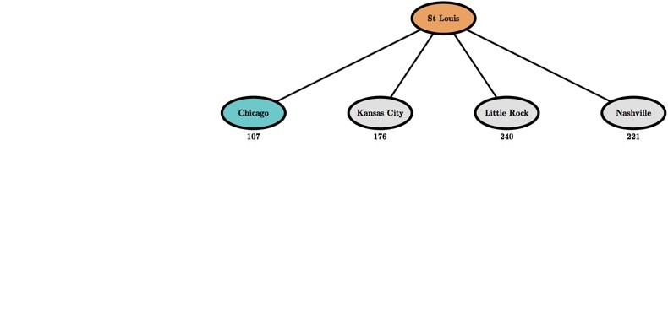
Greedy search example
After expanding St Louis:

Slide 22
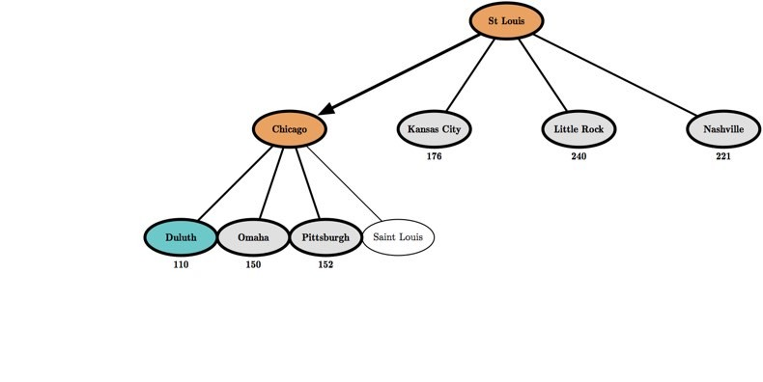
Greedy search example
After expanding Chicago:

Slide 23
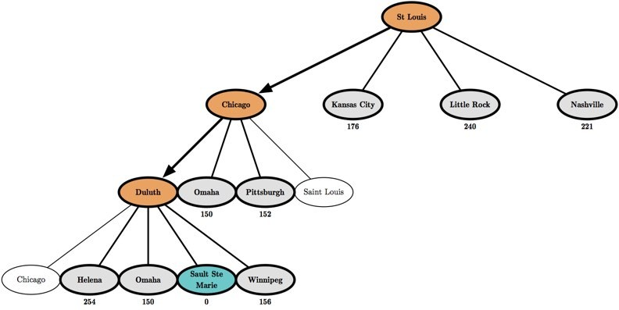
Greedy search example
After expanding Duluth:

Slide 24
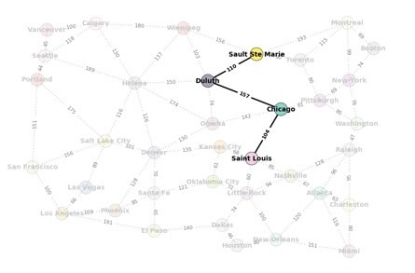
Examples using the map
Start: Saint Louis Goal: Sault Ste Marie
Greedy search

Slide 25
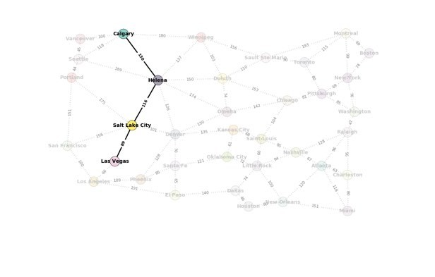
Examples using the map
Start: Las Vegas Goal: Calgary
Greedy search

Slide 26
A* search
Minimize the total estimated solution cost
Combines:
g(n): cost to reach node n
h(n): cost to get from n to the goal
– f (n) = g(n)+ h(n)
f (n) is the estimated cost of the cheapest solution through n

Slide 27

A* search example
The initial state:

Slide 28
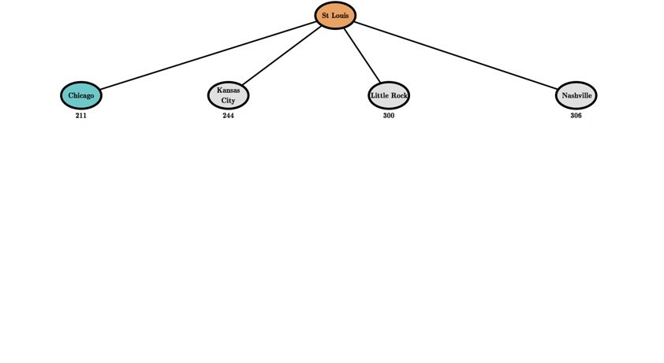
A* search example
After expanding St Louis:

Slide 29
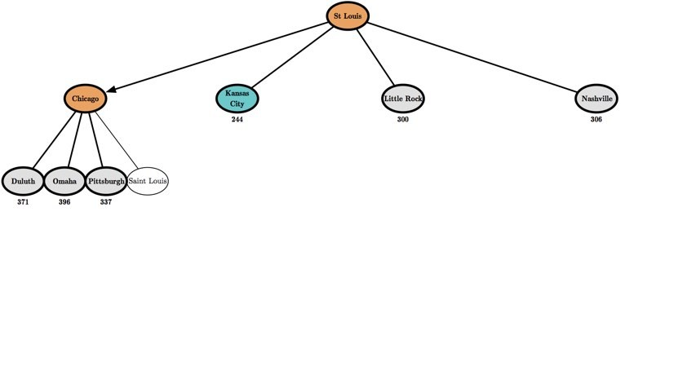
A* search example
After expanding Chicago:

Slide 30
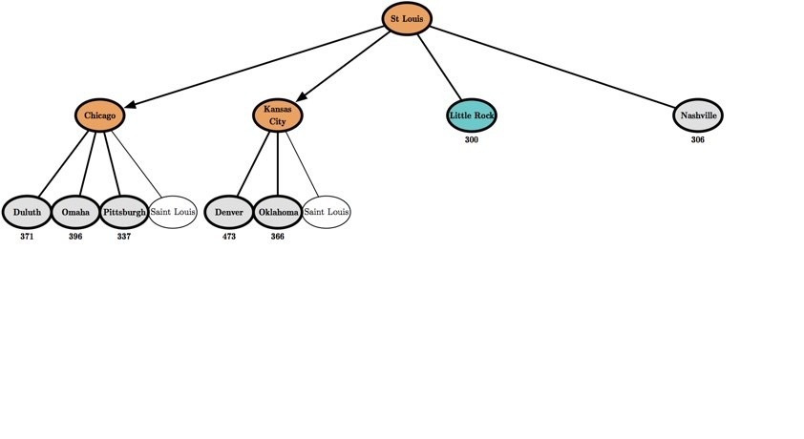
A* search example
After expanding Kansas City:

Slide 31
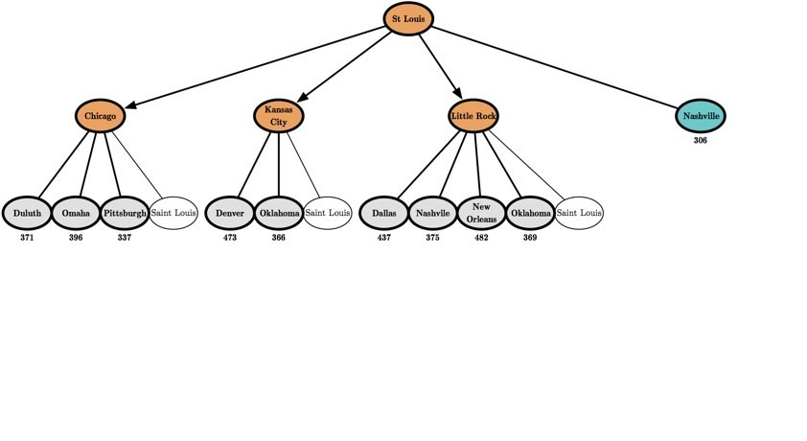
A* search example
After expanding Little Rock:

Slide 32
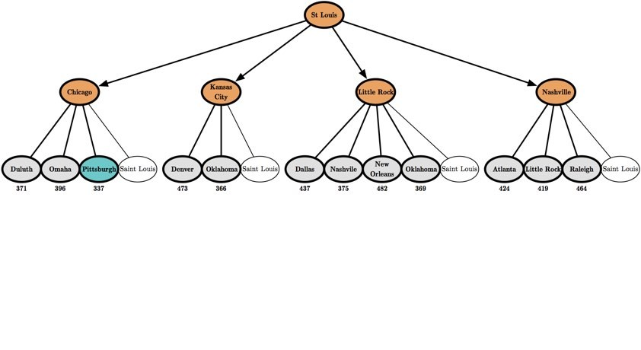
A* search example
After expanding Nashville:

Slide 33
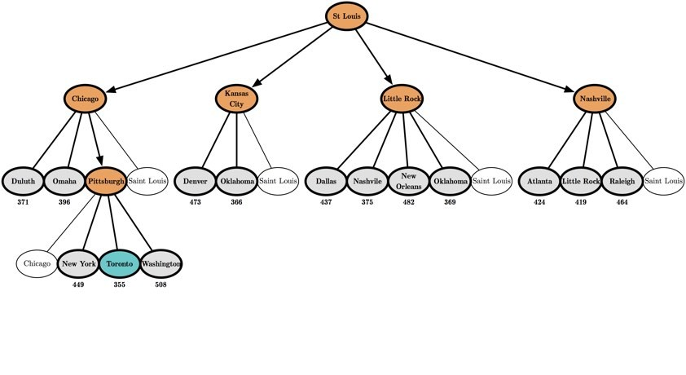
A* search example
After expanding Pittsburgh:

Slide 34
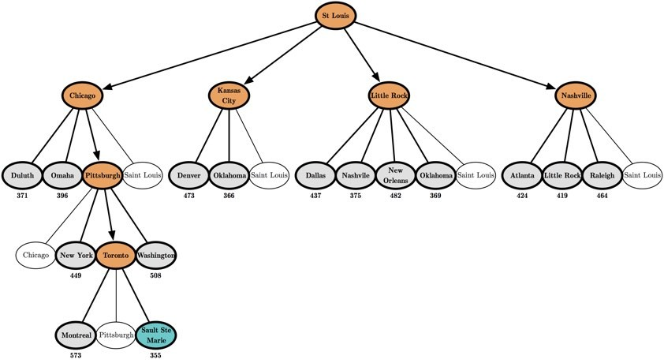
A* search example
After expanding Toronto:

Slide 35
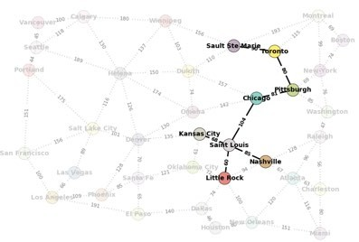
Examples using the map
Start: Saint Louis Goal: Sault Ste Marie
A*

Slide 36
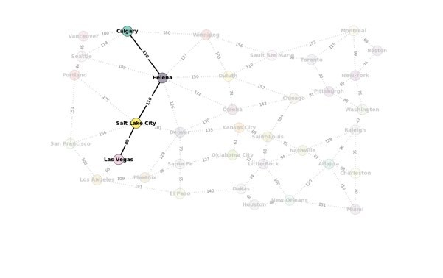
Examples using the map
Start: Las Vegas Goal: Calgary
A*

Slide 37
Heuristic Function
Function h(N) that estimate the cost of the cheapest path
from node N to goal node.
Example: 8-puzzle
5 |  | 8
4 | 2 | 1
7 | 3 | 6
1 | 2 | 3
4 | 5 | 6
7 | 8
h(N) = number of misplaced tiles
= 6
N
goal

Slide 38
Heuristic Function
Function h(N) that estimate the cost of the cheapest path
from node N to goal node.
Example: 8-puzzle
5 |  | 8
4 | 2 | 1
7 | 3 | 6
1 | 2 | 3
4 | 5 | 6
7 | 8
h(N) = sum of the distances of every tile to its goal position
= 2 + 3 + 0 + 1 + 3 + 0 + 3 + 1
= 13
N
goal

Slide 39
Examples of Evaluation function
Let g(N) be the cost of the best path found so far between the initial node and N
f(N) = h(N) → greedy best-first
f(N) = g(N) + h(N)

Slide 40
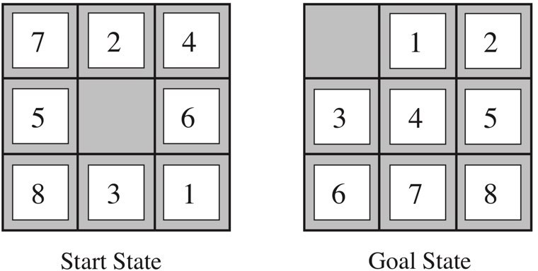
Heuristics
The solution is 26 steps long.
h₁(n) = number of misplaced tiles
h₂(n) =total Manhattan distance (sum of the horizontal and vertical distances).
h₁(n) = 8
Tiles 1 to 8 in the start state gives: h₂ = 3 + 1 + 2 + 2 + 2 + 3 + 3 + 2 = 18 which does not overestimate the true solution.

Slide 41















8-Puzzle
f(N) = h(N) = number of misplaced tiles
3
3
4
5
3
4
2
4
2
1
3
3
0
4
5
4

Slide 42

8-Puzzle
f(N) = g(N) + h(N)
with h(N) = number of misplaced tiles
3+3
1+5
2+3
3+4
5+2
0+4
3+2
4+1
1+3
2+3
5+0
3+4
1+5
2+4

Slide 43


8-Puzzle
f(N) = h(N) = Σ distances of tiles to goal
6
5
2
5
2
1
4
3
0
4
6
5

Slide 44
Search Algorithms: Recap
Uninformed Search: Use no domain knowledge.
BFS, DFS, DLS, IDS, UCS.
Informed Search: Use a heuristic function that estimates how close a state is to the goal.
Greedy search, A*, IDA*.

Slide 45
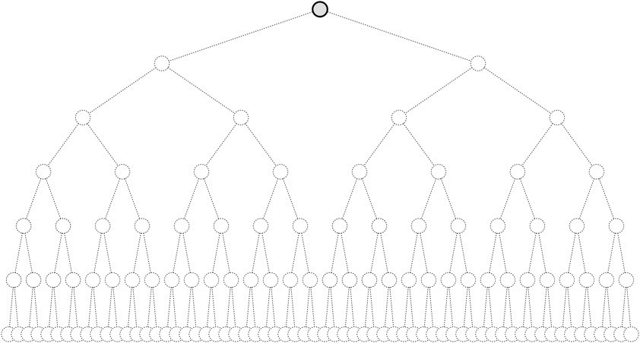
DFS
Searches branch by branch ...
... with each branch pursued to maximum depth.

Slide 46
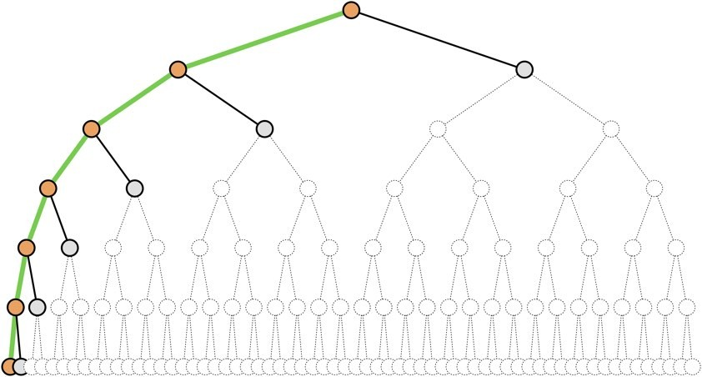
DFS
Searches branch by branch ...
... with each branch pursued to maximum depth.

Slide 47
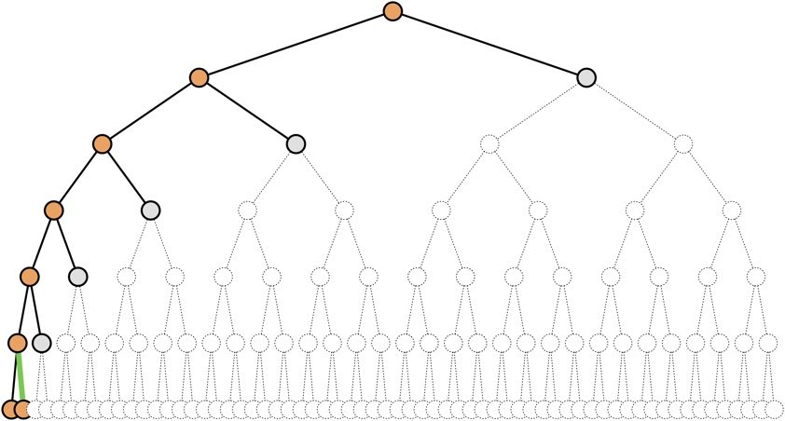
DFS
Searches branch by branch ...
... with each branch pursued to maximum depth.

Slide 48
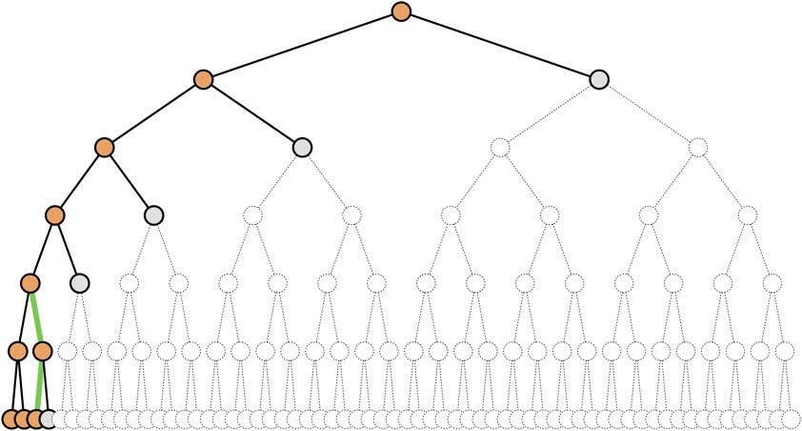
DFS
Searches branch by branch ...
... with each branch pursued to maximum depth.

Slide 49
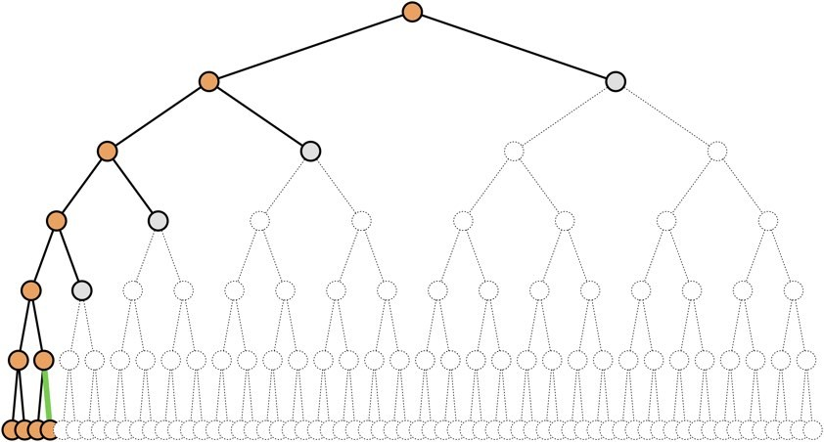
DFS
Searches branch by branch ...
... with each branch pursued to maximum depth.

Slide 50
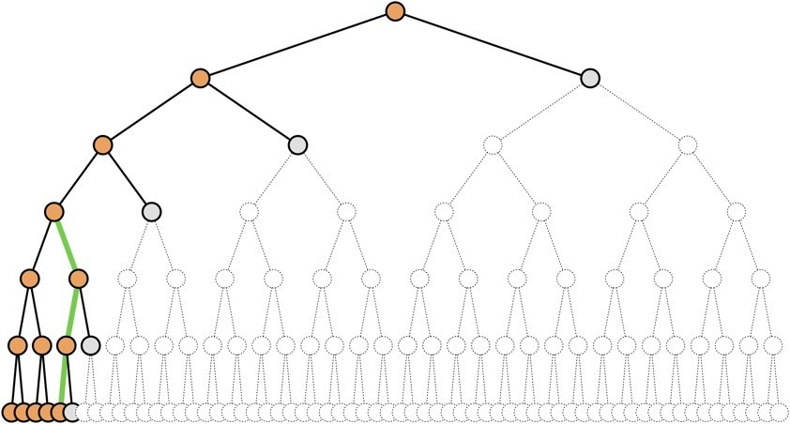
DFS
Searches branch by branch ...
... with each branch pursued to maximum depth.

Slide 51
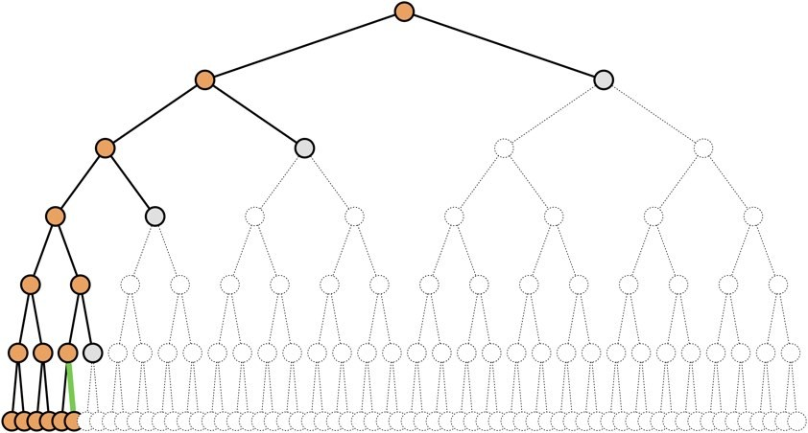
DFS
Searches branch by branch ...
... with each branch pursued to maximum depth.

Slide 52
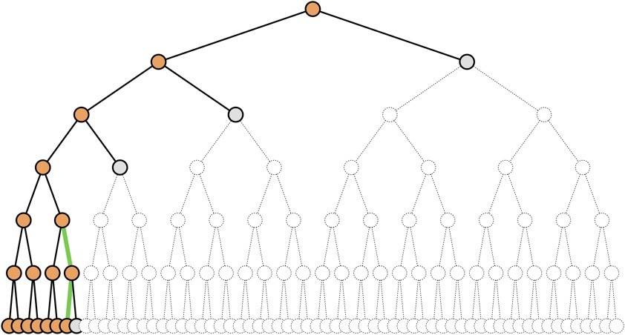
DFS
Searches branch by branch ...
... with each branch pursued to maximum depth.

Slide 53
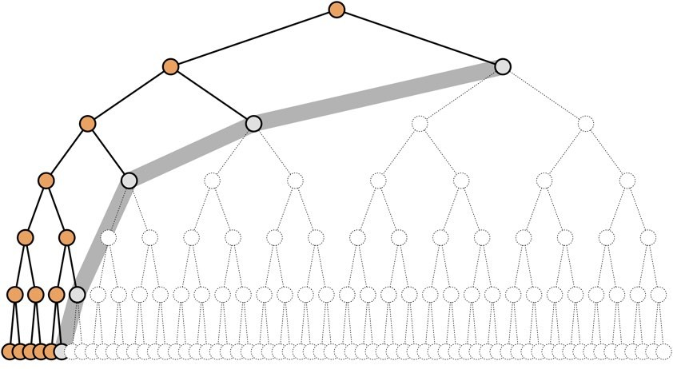
DFS
The frontier consists of unexplored siblings of all ancestors. Search proceeds by exhausting one branch at a time.

Slide 54
BFS
Searches layer by layer ...
... with each layer organized by node depth.

Slide 55
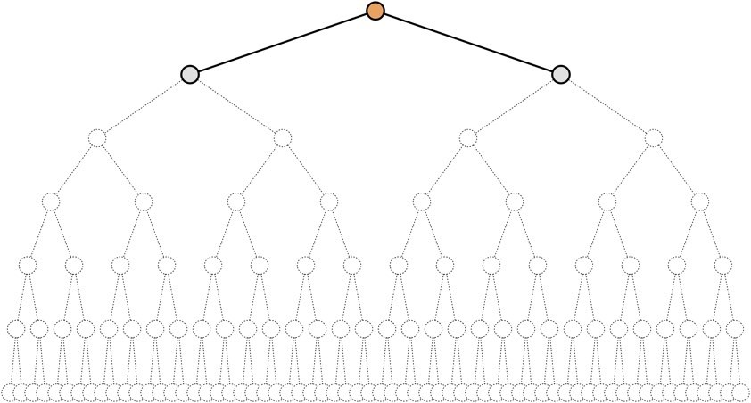
BFS
Searches layer by layer ...
... with each layer organized by node depth.

Slide 56
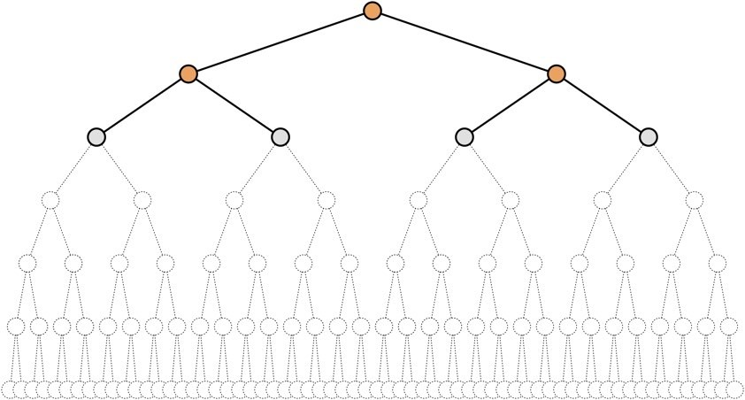
BFS
Searches layer by layer ...
... with each layer organized by node depth.

Slide 57
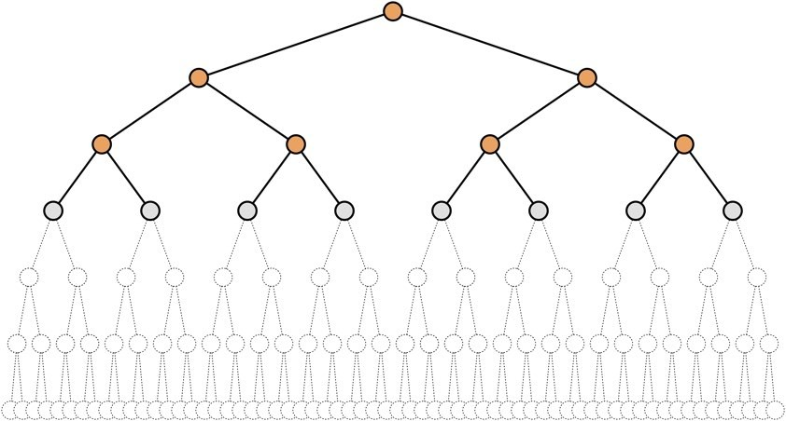
BFS
Searches layer by layer ...
... with each layer organized by node depth.

Slide 58
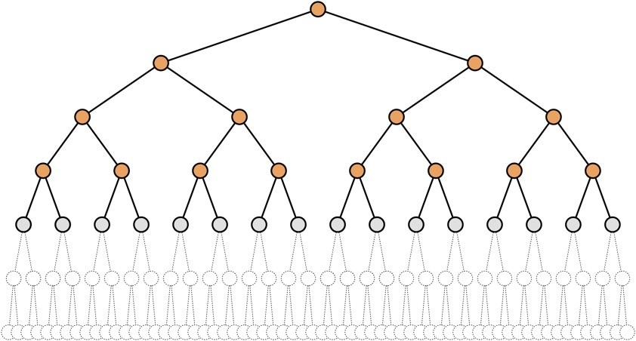
BFS
Searches layer by layer ...
... with each layer organized by node depth.

Slide 59
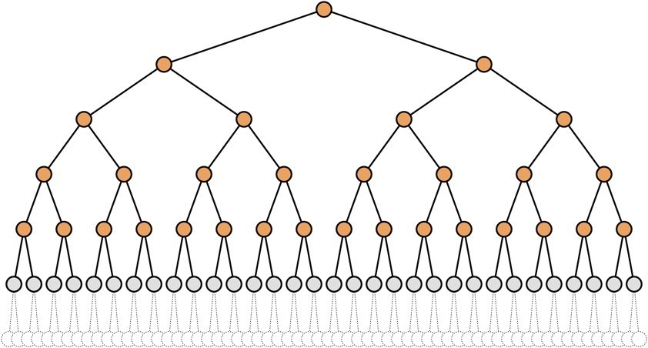
BFS
Searches layer by layer ...
... with each layer organized by node depth.

Slide 60
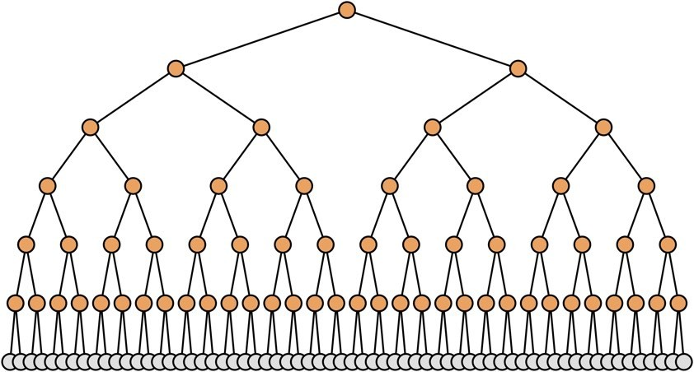
BFS
Searches layer by layer ...
... with each layer organized by node depth.

Slide 61
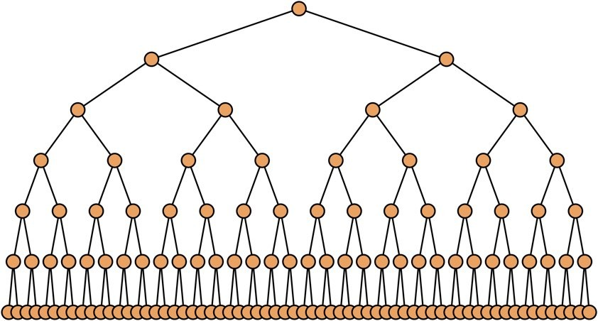
BFS
Searches layer by layer ...
... with each layer organized by node depth.

Slide 62
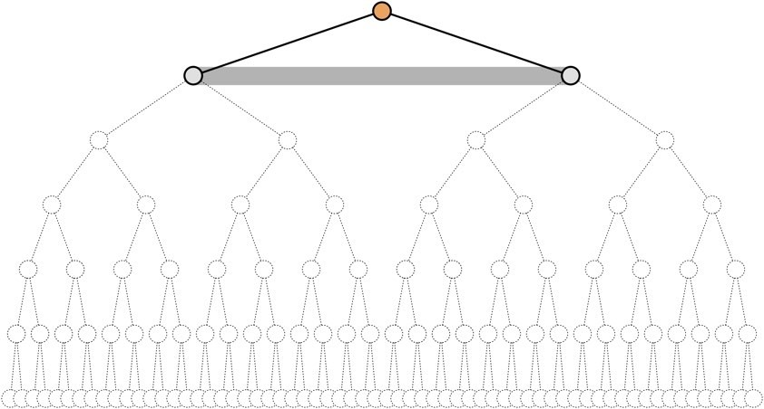
BFS
The frontier consists of nodes of similar depth (horizontal). Search proceeds by exhausting one layer at a time.

Slide 63
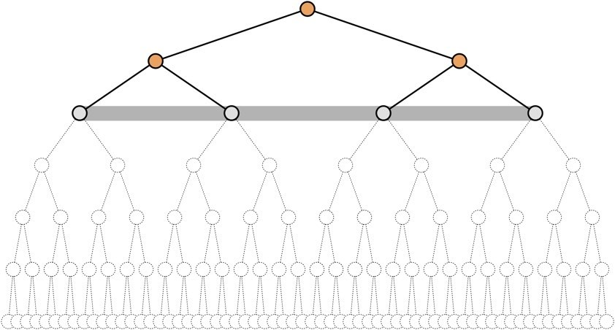
BFS
The frontier consists of nodes of similar depth (horizontal). Search proceeds by exhausting one layer at a time.

Slide 64
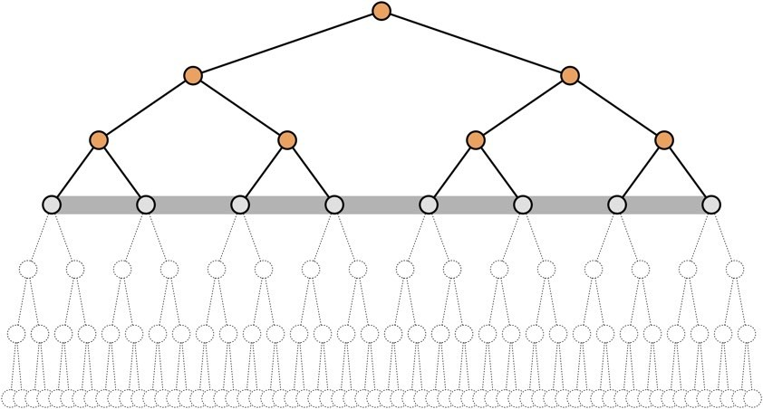
BFS
The frontier consists of nodes of similar depth (horizontal). Search proceeds by exhausting one layer at a time.

Slide 65
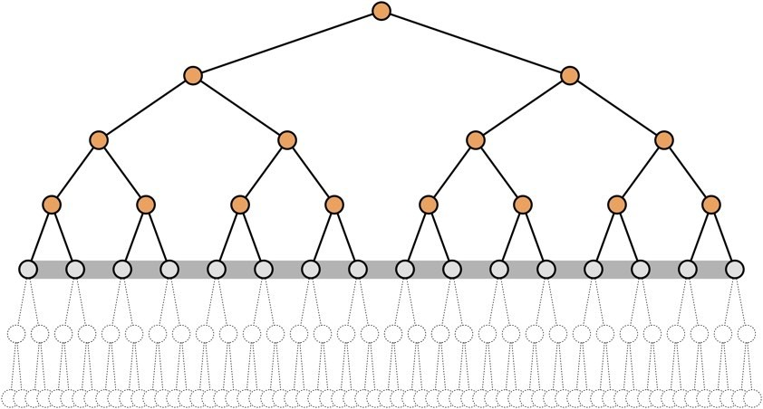
BFS
The frontier consists of nodes of similar depth (horizontal). Search proceeds by exhausting one layer at a time.

Slide 66
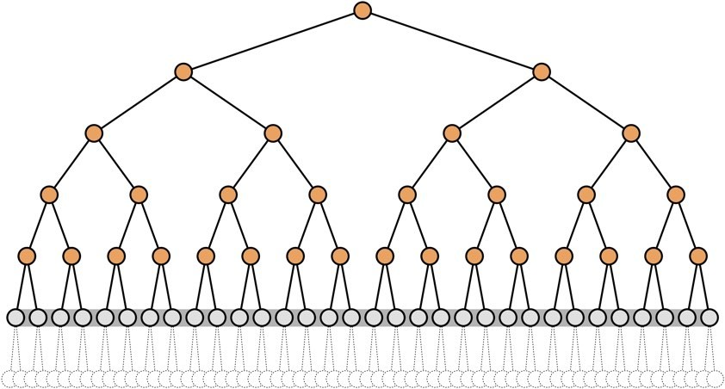
BFS
The frontier consists of nodes of similar depth (horizontal). Search proceeds by exhausting one layer at a time.

Slide 67
UCS
Searches layer by layer ...
... with each layer organized by path cost.

Slide 68
UCS
Searches layer by layer ...
... with each layer organized by path cost.

Slide 69

UCS
Searches layer by layer ...
... with each layer organized by path cost.

Slide 70

UCS
Searches layer by layer ...
... with each layer organized by path cost.

Slide 71

UCS
Searches layer by layer ...
... with each layer organized by path cost.

Slide 72

UCS
Searches layer by layer ...
... with each layer organized by path cost.

Slide 73

UCS
Searches layer by layer ...
... with each layer organized by path cost.

Slide 74

UCS
Searches layer by layer ...
... with each layer organized by path cost.

Slide 75
UCS
The frontier consists of nodes of various depths (jagged). Search proceeds by expanding the lowest-cost nodes.

Slide 76

UCS
The frontier consists of nodes of various depths (jagged). Search proceeds by expanding the lowest-cost nodes.

Slide 77

UCS
The frontier consists of nodes of various depths (jagged). Search proceeds by expanding the lowest-cost nodes.

Slide 78

UCS
The frontier consists of nodes of various depths (jagged). Search proceeds by expanding the lowest-cost nodes.

Slide 79

UCS
The frontier consists of nodes of various depths (jagged). Search proceeds by expanding the lowest-cost nodes.

Slide 80

UCS
The frontier consists of nodes of various depths (jagged). Search proceeds by expanding the lowest-cost nodes.

Slide 81

UCS
The frontier consists of nodes of various depths (jagged). Search proceeds by expanding the lowest-cost nodes.

Slide 82
Recap
We can organize the algorithms into pairs where the first proceeds by layers, and the other proceeds by subtrees.
Iterate on Node Depth:
BFS searches layers of increasing node depth.
IDS searches subtrees of increasing node depth.

Slide 83
Recap
We can organize the algorithms into pairs where the first proceeds by layers, and the other proceeds by subtrees.
Iterate on Node Depth:
BFS searches layers of increasing node depth.
IDS searches subtrees of increasing node depth.
Iterate on Path Cost + Heuristic Function:
A* searches layers of increasing path cost + heuristic function.
IDA* searches subtrees of increasing path cost + heuristic function.

Slide 84
Recap
Which cost function?
UCS searches layers of increasing path cost.
Greedy best first search searches layers of increasing heuristic function.
A* search searches layers of increasing path cost + heuristic function.

